Slide 1
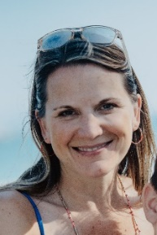
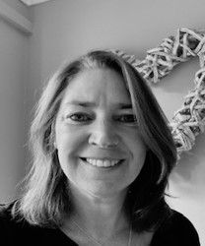
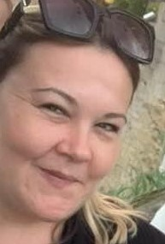
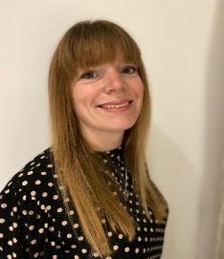
Meet Our Advisory Board
Chair
I am a Teacher at Catmose College and Harington and the mother of three boys. I've lived in Uppingham since 2004 and before that I worked and lived in London - in PR and Marketing, before a career move into teaching. My youngest son Barnaby is currently in Year 4 and Henry (now Y7) and Louis (now Y9) were both very happy at Leighfield. Louis started at Leighfield in 2011 which is when I became a member of the governing body. I became Chair in 2013 and since then we have seen many changes. Leighfield first became an Academy, then became part of DSAT and of course we've had a change in leadership from Mrs Sedgewick to Mrs Eaton. Staff too have changed of course but many remain and I think this for me is what I love about Leighfield - the sense of the tradition and core values that have remained the same and yet all the time the school is evolving and adapting. The way that Leighfield has embraced remote learning to enable our children to continue their education, for example, is testament to the staff's hard-work and dedication to ensure children stay engaged.
Vice Chair
Hello, I’m Miranda Jones. I’ve been a community member of Leighfield’s Advisory Board since 2019 . As a Town and County Councillor for Uppingham I am passionate about our community. The staff at Leighfield School are truly inspirational and it is an honour to be able to support them. I’m very much looking forward to getting to know the school better once the Lockdown restrictions are eased.
Staff Board Member
I joined Leighfield Primary in 2014 as a Teaching Assistant. I love working at this school and I am lucky to be involved in the schools sporting events, speech and language, and wellbeing as well as my classroom role . I am also an ELSA and DSL.
Prior to Leighfield I worked in Human Resources for 20 years in a variety of roles in Retail, Hotels and Distribution, across the UK and Europe.
I have a son at UCC who attended this school and in my free time I enjoy running, walking, football, swimming and visiting the seaside . I am passionate about working with children and being part of the Advisory Board enables me to support the school in being the best that it can be for its staff, parents and the children.
Parent Board Member
Hello, I’m Libby Garden, I have been on the Advisory Board since 2019. I am also the Chair of FOLS and Head Fundraiser for UCC. Leighfield is a very special school to me, all 4 of my children have loved being at Leighfield. I especially love the rural location and wide open spaces that the school has to offer, I enjoy working locally at Rutland County Council as an LFT Officer and am happy to support our local community.
Parent Board Member
My name is Hannah Roddy, I was a teacher at Leighfield for 17 years before leaving last year to become a Headteacher. I have two children still at Leighfield and have joined the Advisory Board as a Parent governor. Leighfield is such a special school and I can't wait to keep in touch through my new role and help support the team to keep up the good work!
Community Board Member
Hi everyone my name is Barry Read, and I have been in business virtually all my life. I lived in North London, and sent my son to Uppingham school, so I have a very fond memory of the area. When I decided to semi-retire in 2006, my wife and I thought hard and long about where to move, and unanimously said ‘Uppingham’. Since arriving I have been Chair and Trustee of Citizens Advice, and a Trustee of North Luffenham village which incorporated the school. I enjoy working /helping locally, which is why I am happy to be on the advisory board of Leighfield Primary School.

